Slide 1

Online Spectacles Purchase with Spring Boot
Explore building an e-commerce platform for spectacles. Key features include product catalogs and user authentication. Also, shopping carts, payment gateways, and order management are critical. This presentation provides an overview of building the platform using Spring Boot.

Slide 2
Spring Boot Architecture for E-commerce
Layered Architecture
RESTful API Design
Utilize a layered approach. This includes Controller, Service, and Repository layers.
Adhere to RESTful API design principles for seamless communication. An example endpoint: GET /api/products.
Design considerations for microservices architecture are critical. Separate services for catalog, users, and orders improve scalability.

Slide 3

Database Design: Spectacle Data Model
Spectacle Entity
User Entity
Includes id, brand, model, type, shape, material, color, lens_options, price, image_url, and quantity_in_stock.
Consists of id, username, password, email, address, and payment_info.
Order Entity
Includes id, user_id, order_date, total_amount, shipping_address, order_status, and payment_status.
Establish one-to-many (user-orders) relationships. Also create many-to-many (orders-spectacles) relationships.

Slide 4
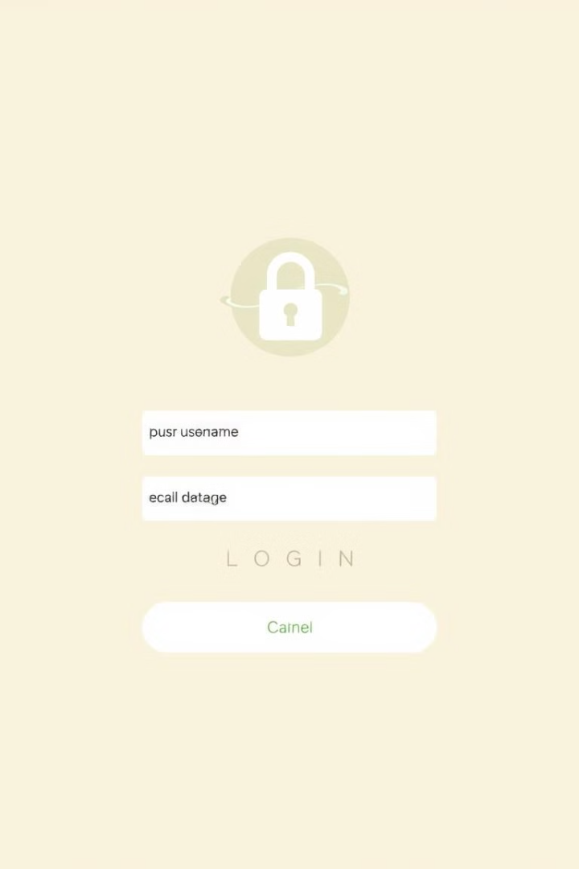



User Authentication and Authorization
Spring Security
Implement Spring Security for robust authentication.
JWT
Utilize JWT for secure authentication.
Role-Based Access Control
Implement Role-Based Access Control.
Example endpoints: POST /api/auth/register and POST /api/auth/login. Integrate OAuth 2.0 for social login.

Slide 5
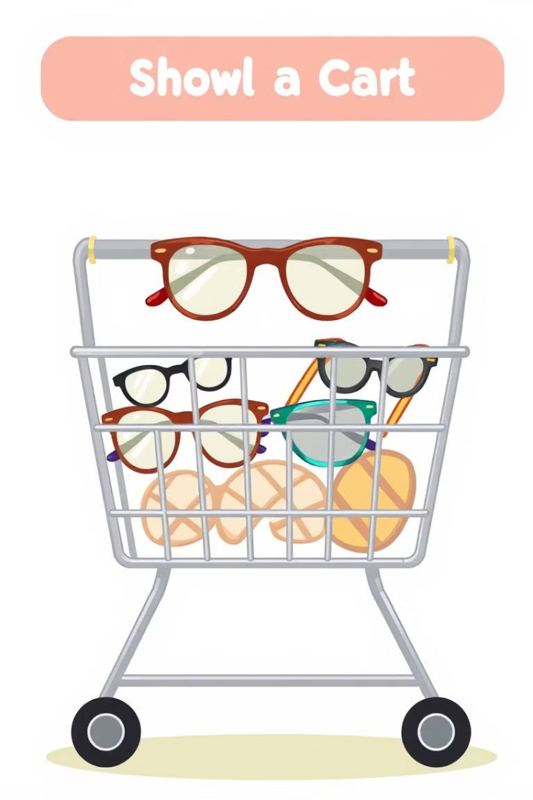



Shopping Cart and Order Management
Session Management
CRUD Operations
Payment Gateway
Implement session management for the shopping cart.
Enable CRUD operations on cart items.
Integrate payment gateways like Stripe or PayPal.
API endpoints: POST /api/cart/add, GET /api/cart/view, and POST /api/orders/place.

Slide 6
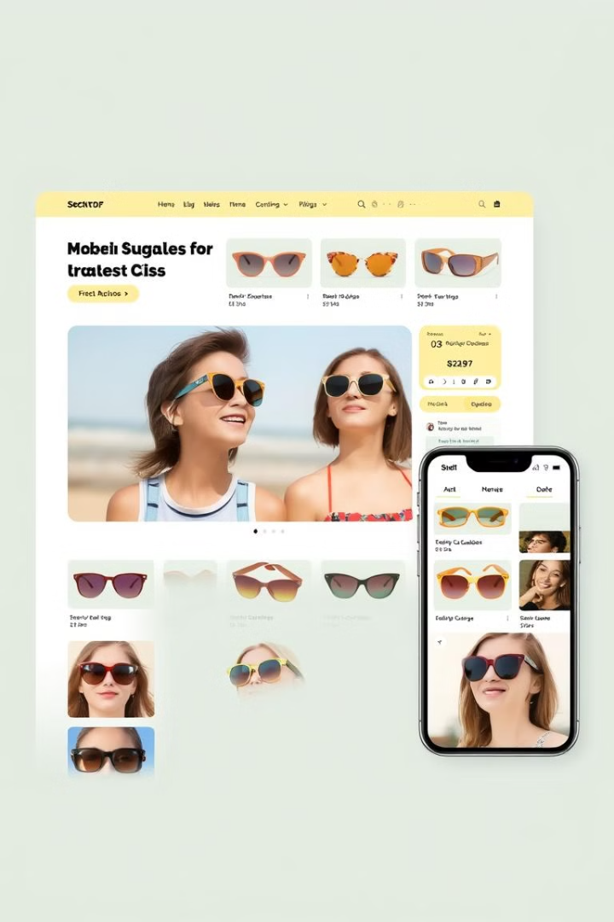
Frontend Development with React
1
UI Components
Develop UI components for the product catalog.
2
State Management
Manage state using Redux or Context API.
3
API Integration
Integrate with Spring Boot REST APIs.
Design a responsive layout. Display spectacle details with image zoom.

Slide 7



Testing and Deployment
Integration Testing
2
Integrate Spring Test for integration tests.
Unit Testing
1
Use JUnit and Mockito for unit tests.
End-to-End Testing
Use Cypress or Selenium for end-to-end tests.
3
Explore deployment options using Docker, AWS, Heroku, or Kubernetes. Implement CI/CD pipelines.

Slide 8

Future Enhancements and Conclusion
1
Personalized Recommendations
2
Virtual Try-On
3
Insurance Integration
Integrate a virtual try-on feature using AR/VR.
Integrate with vision insurance providers.
Base recommendations on user preferences.
In conclusion, Spring Boot offers a robust framework. It builds scalable e-commerce platforms for online spectacles.

